Slide 1


Parallel and Distributed Systems / 4
Pavel Krömer, Dept. of Computer Science, VSB – Technical University of Ostrava

Slide 2
Agenda
Models, tools, and frameworks for shared memory multiprocessing
already discussed: a dive-in to fork-join with OpenMP
Literature
Michael D. McCool, James Reinders, Arch D. Robison, Structured Parallel Programming: Patterns for Efficient Computation, Elsevier, 2012. Ch. 1: Introduction, pp. 1 – 38
Michael Voss, Rafael Asenjo, James Reinders, Pro TBB: C++ Parallel Programming with Threading Building Blocks, Apress, 2019

Slide 3
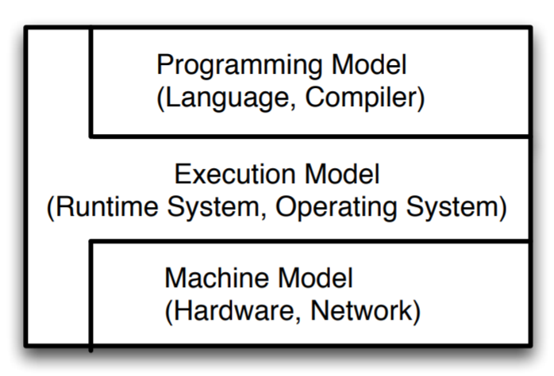
Components of a parallel programming framework

Slide 4
Components of a parallel programming framework
Constructs for exposing and expressing parallelism
syntax for parallelism in a programming language
high- and low-level approaches
threads vs. parallel sections
shared memory vs. message passing
WHAT

Slide 5
Components of a parallel programming framework
Operational semantics for the model
an abstraction of computation that links the programming and machine model
communication, locality, synchronization, etc, used to allow parallelism with maximum efficiency
yes, the borders are quite fuzzy
data-parallel; message-driven
HOW

Slide 6
Components of a parallel programming framework
Abstract model isolating the computation from machine details
efficiency, portability, interoperability, tools and infra
optimization to the level of target HW architectures
WHERE

Slide 7
Charm ++
Notes:
what do we associate with digital transformation/DSM?
Is that all new? Is this change the first?

Slide 8
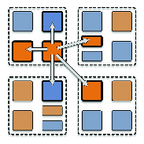
Charm++
High-level parallel programming model (PPL University of Illinois, Urbana-Champaign)
Object-oriented, application is a collection of communicating objects
Based on the notion of chares, special objects with data, ability to send and receive messages, and execute tasks
Communication (message passing) asynchronous to code execution
C++, Python

Slide 9
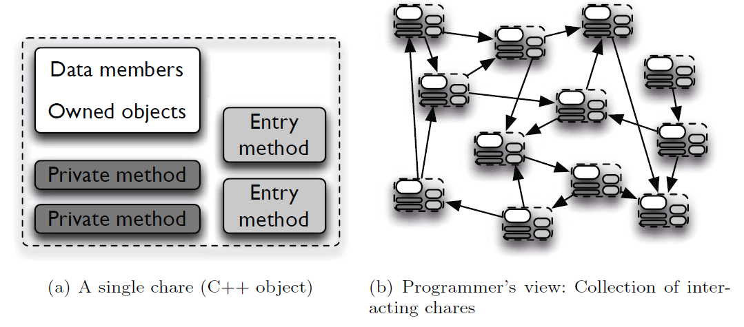
Charm++ Chares
Units of parallel execution (application decomposition), migrating across processors
Virtual processors

Slide 10
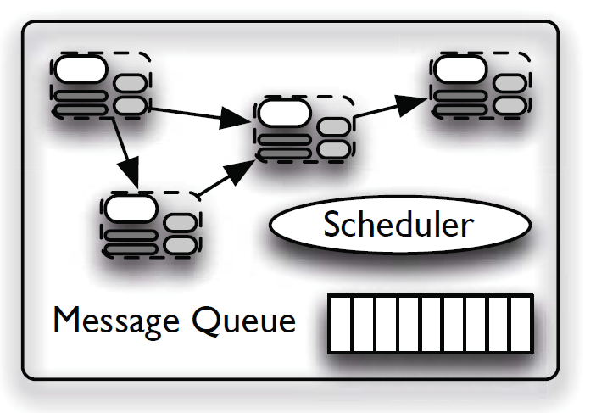
Charm++ execution model
Based on the actor programming model and data-flow execution model
Relies on the parallel slackness property
parallelism in an application largely exceeds the no. of processors
Runtime can employ intelligent load-balancing and task scheduling etc.
automatic overlap between communication and computation
Message-driven scheduler on each processor
selects one of the entry method invocations targeted at some
object residing on its processor, unpacks the parameters for the invocation and
executes the entry method on the identified object with the given parameters

Slide 11
Charm++ load balancing
Chares assigned to CPU cores by the Charm++ runtime
Several load balancers with different strategies
Greedy
Refine
Hierarchical
Energy-aware
Load balancing goals
volume of computation; minimization of communication volume

Slide 12
Intel Thread Building Blocks
Notes:
what do we associate with digital transformation/DSM?
Is that all new? Is this change the first?

Slide 13
Intel Thread Building Blocks
A C++ template library for parallel programming
Based on
Parallel algorithms and data structures
Task scheduling and work stealing
Threads and synchronization primitives

Slide 14
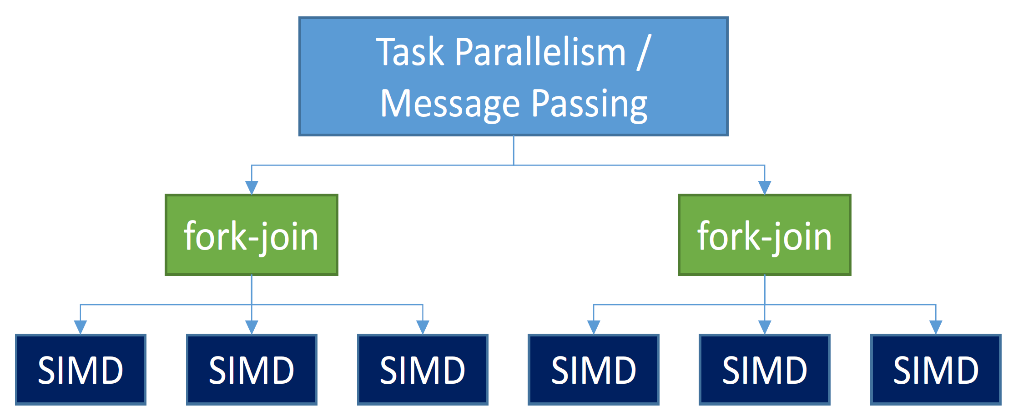
TBBs perspective on SHM apps
Three levels of parallelism in a (shared memory) application

Slide 15
Intel Thread Building Blocks
Implements a relaxed sequential execution model
use as much parallelism as possible, but still be able to run in a single thread
the sequential execution does not need to be super efficient
vs. programs that require parallelism to run correctly (e.g., producer-consumer)

Slide 16
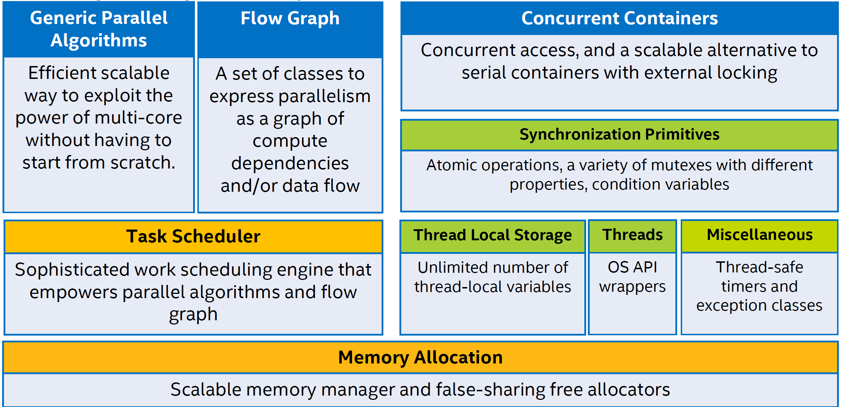
Intel Thread Building Blocks
Notes:
Page 7:
TBB Parallel execution interfaces:
Algorithms (patterns); Flow graph; Parallel STL
Low-level interfaces: tasks, Task arenas, Global control
Execution model independent TBB interfaces:
Concurrent containers: Hash tables, Queues, Vectors
Memory allocation
Sync primitives, thread-local storage

Slide 17
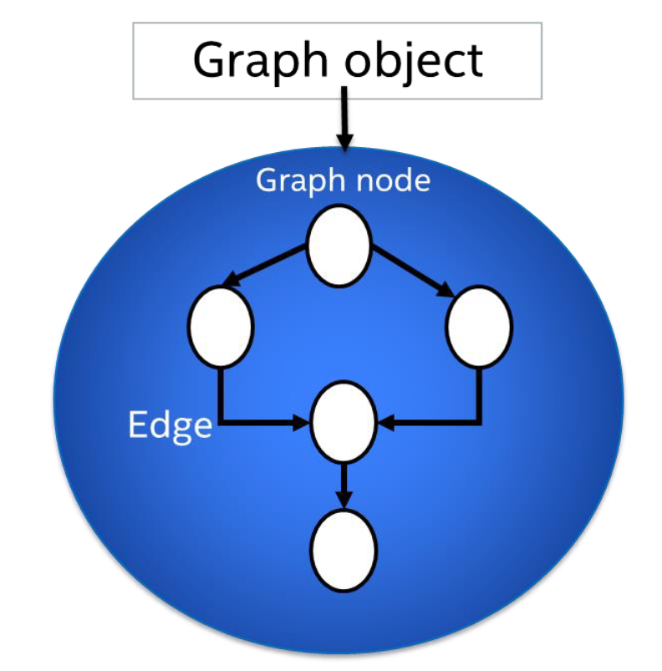
TBB Flow Graph
Developers exploit parallelism at the design level
A high-level design concept for shared memory applications
Parallelism as large computations that communicate by explicit message passing
Allows an efficient implementation of data flows and the representation of dependencies
Graph structure can be used at runtime to schedule the computations in parallel

Slide 18
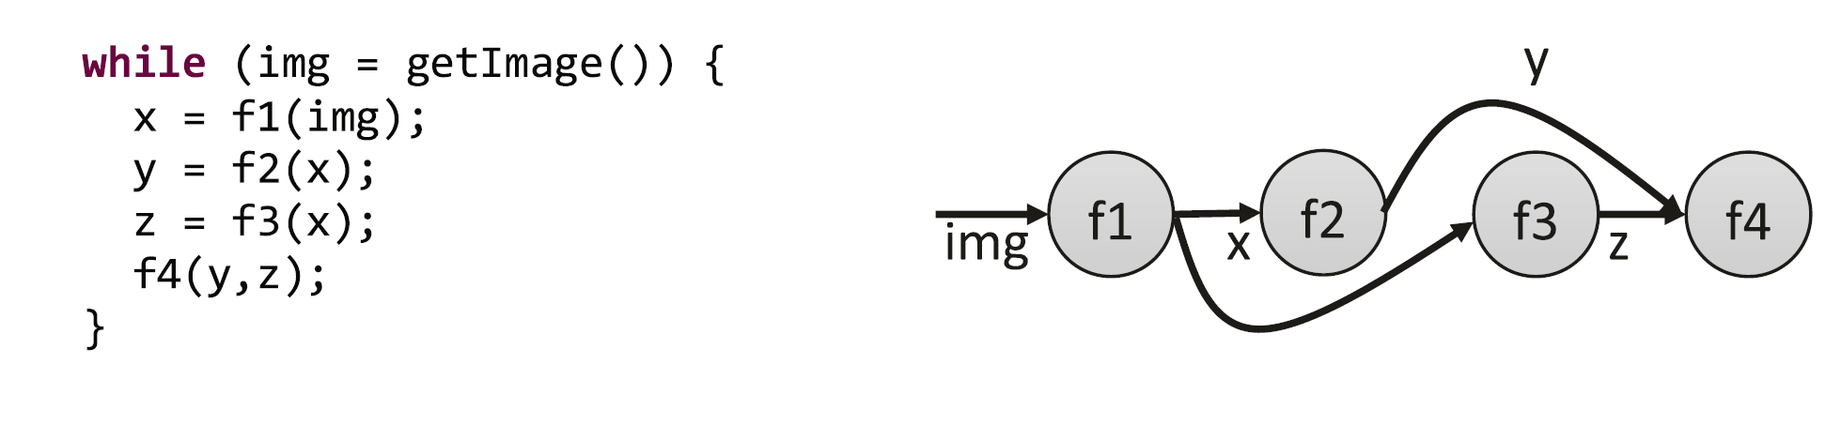
TBB Flow Graph

Slide 19
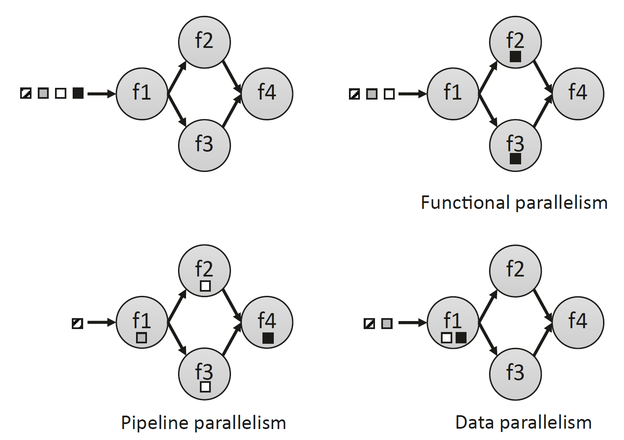
TBB Flow Graph

Slide 20
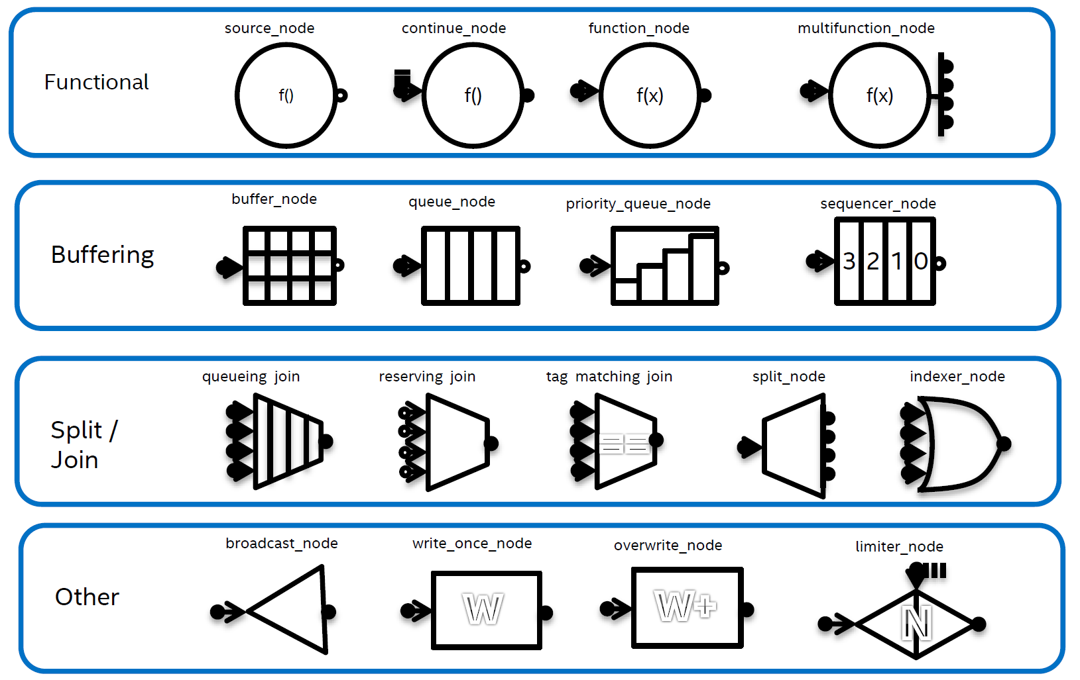
TBB Flow Graph
Support of various node types

Slide 21
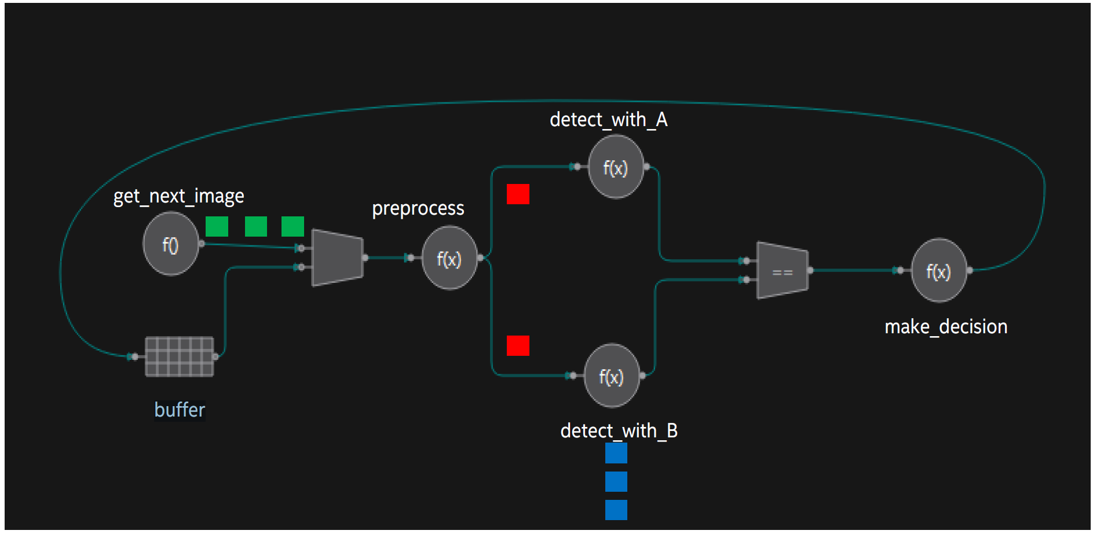
TBB Flow Graph
Ability to model various parallel concepts
Pipelining
Task parallelism
Data parallelism

Slide 22
Intel Thread Building Blocks

Slide 23
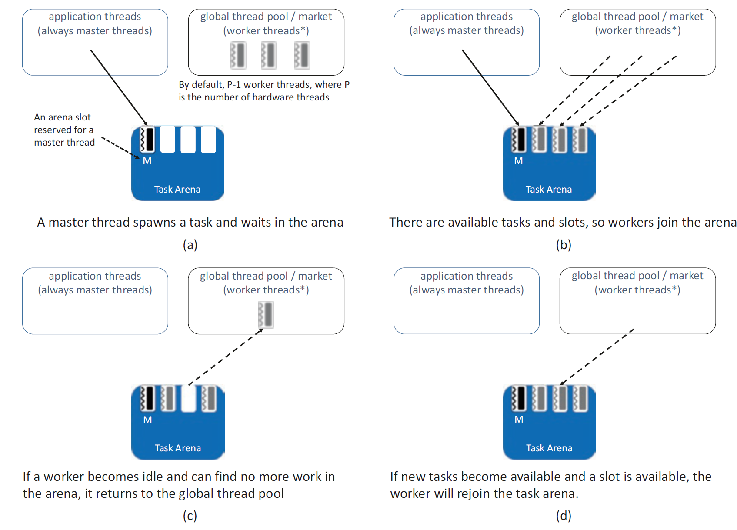
TBB task scheduling
Based on work-stealing
worker threads actively look for new work when they become idle (cmp. with work-sharing)
good for dynamic environments with applications that dynamically spawn many tasks
Uses global thread pool (the Market) and Task arenas

Slide 24
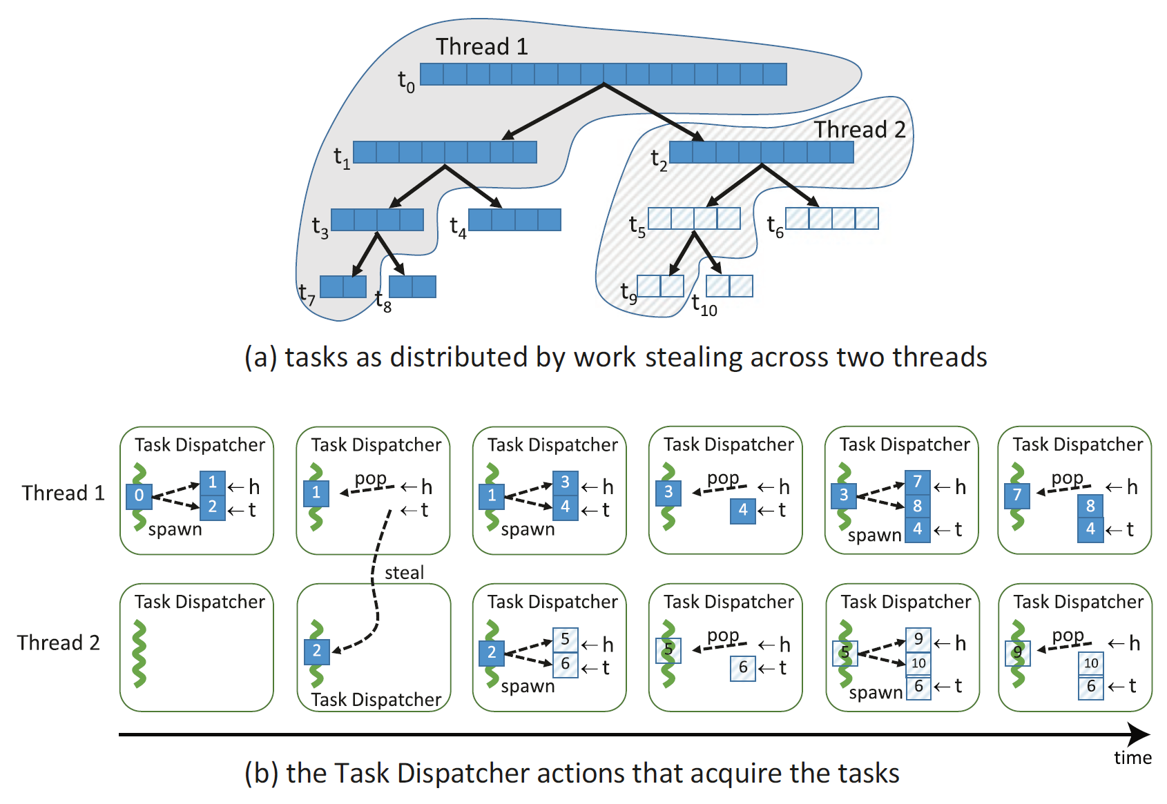
TBB task scheduling

Slide 25
Parallel Matlab
Notes:
what do we associate with digital transformation/DSM?
Is that all new? Is this change the first?

Slide 26
Parallelism in Matlab
Matlab is a high-level language and interactive environment for numerical computation.
Support for parallel programming via the Parallel Computing Toolbox
runs on multicore processors, GPUs, and computer clusters
supports parallel for-loops, special array types, and parallelized numerical algorithms

Slide 27
Parallelism in Matlab
Basic elements of a parallel computation within Matlab
client - a Matlab session that submits a job
communicate job - a job composed of communicating tasks
independent job - a job composed on independent tasks
lab - an analogy of worker in other languages
pool - a collection of labs
parfor - parallel for loop
boradcast, reduction, and sliced variables

Slide 28
Parallelism in Matlab

Slide 29
Parallel Python
Notes:
what do we associate with digital transformation/DSM?
Is that all new? Is this change the first?

Slide 30




Parallel Python
Python is an object-oriented, interpreted, and interactive programming language. Easy and fun ₍₂₀₁₄₎
Python is of paramount importance for data science _{(now)}

Slide 31
Parallel Python
Parallel programming in Python
Not as easy as it could be
Python is an interpreted (JIT compiled) language with automated memory management
GIL (in CPython) is a mutex that prevents multiple native threads from executing Python bytecodes at once
it is necessary for CPython’s (no thread safe) memory management
overcome by is multiprocessing

